Slide 1
Java 4 WEB
Lesson 1 - Intro

Slide 2

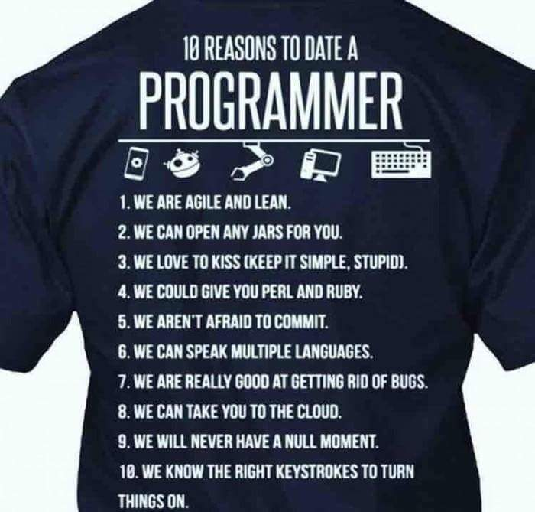
Goals
Read
Understand
Update
Create
Notes:
Become a true programmer

Slide 3
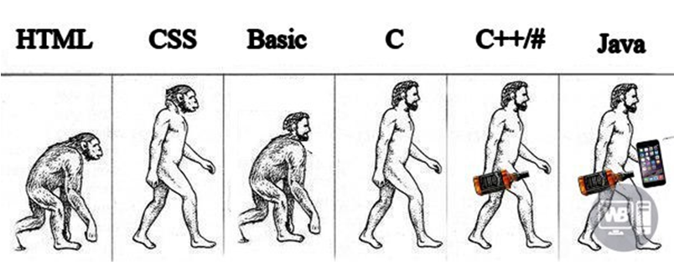
Goals

Slide 4
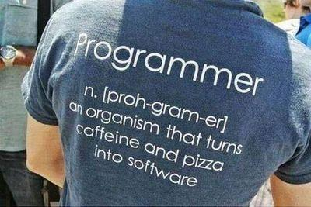
First lesson goals
What is Java
Basic Java
Variables
Datatypes
Modifiers
Operators
Structure
Code synchronization

Slide 5
JVM vs JRE vs JDK
Java Virtual Machine - machine that run the Java bytecodes. Write once, run anywhere;
Java Runtime Environment – libraries and other components to run applications written in the Java programming language in JVM;
Java Development Kit - is a superset of JRE, contains everything that are in the JRE, plus tools such as the compilers and debuggers necessary for developing applications.
Notes:
JVM - The JVM doesn't understand Java source code, that's why you compile your *.java files to obtain *.class files that contain the bytecodes understandable by the JVM. It's also the entity that allows Java to be a "portable language" (write once, run anywhere). Indeed there are specific implementations of the JVM for different systems, the aim is that with the same bytecodes they all give the same results

Slide 6
Java Platform Editions
1. Java SE: client-side applications on desktops and applets in web browsers;
2. Java EE: enterprise-oriented server applications - servlets. Servlets satisfies the Java EE Servlet API requirements;
3. Java ME: MIDlets - run on mobile information devices and Xlets for embedded devices.
Notes:
Servlets - Java programs that are similar to applets but run on a server rather than a client

Slide 7
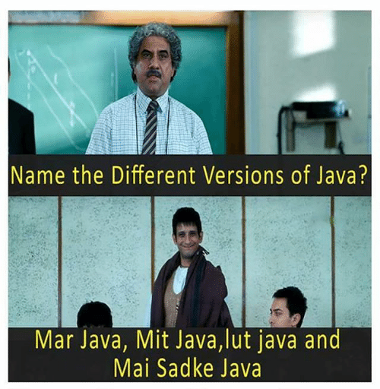
Java Versions

Slide 8
Java Versions
JDK 1.0 (January 1996)
JDK 1.1 (February 1997)
J2SE 1.2 (December 1998)
J2SE 1.3 (May 2000)
J2SE 1.4 (February 2002)
J2SE 5.0 (September 2004)
Java SE 6 (December 2006)
Java SE 7 (July 2011)
Java SE 8 (March 2014)
Java SE 9 (September 2017)
Java SE 10 (March 2018)
Java SE 11 (September 2018)

Slide 9


Slide 11
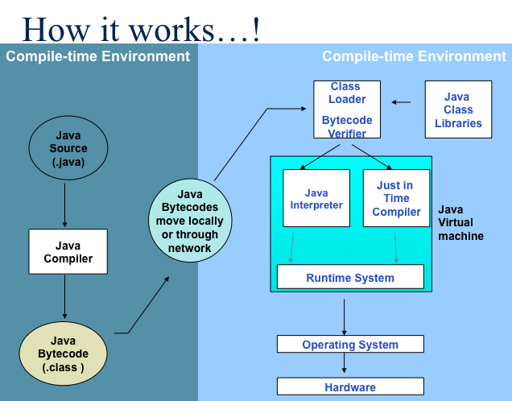

Slide 12
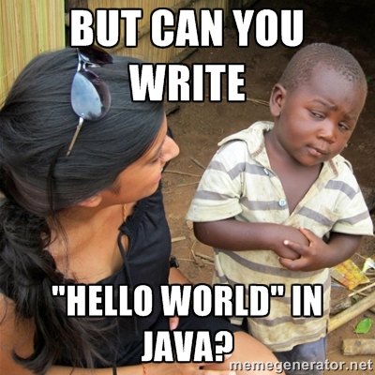

Slide 13
Hello World!!!
public class HelloWorld { public static void main(String args[]) { System.out.println("Hello World!!!"); } }
c:\> javac HelloWorld.java
c:\> java HelloWorld

Slide 14
Program
=
Code
+
Whitespaces
+
Comments
double a = 1;
double b = 1;
double c = 6; double D = b * b - 4 * a * c; /* discriminant */ if (D >= 0) { double x1 = (-b + Math.sqrt (D)) / (2 * a); double x2 = (-b - Math.sqrt (D)) / (2 * a); }
The same to
double a=1,b=1,c=6;double D=b*b-4*a*c;if(D>=0) {double x1=(-b+Math.sqrt(D))/(2*a);double x2=(-b-Math.sqrt(D))/(2*a);}

Slide 15
Java Syntax
Static typed
Case sensitive
Statements separated by semicolon ;
Wrap blocks in braces {}
Spaces (4) vs tabulation
Comments
// one line
/* multiline */
/**Java doc */

Slide 16
Identifiers
Valid:
Character, c, D, x1, x2, Math, sqrt, x,
PI, condition, getWidth, getHeight,lang, stack,
Stack, STACK_SIZE, wav2snd, _snd, $snd
Invalid:
1var, assert, class, very-bad, %illegalName
Optimal length 8, not more than 15 symbols
Notes:
An identifier is a sequence of one or more characters
Packages, classes, fields, variables, methods, arguments…
The first character must be a letter, $, _
Subsequent character in the sequence must be letter, digit, $, _

Slide 17
Read and remember Code Convention!
By Oracle
By Google

Slide 18
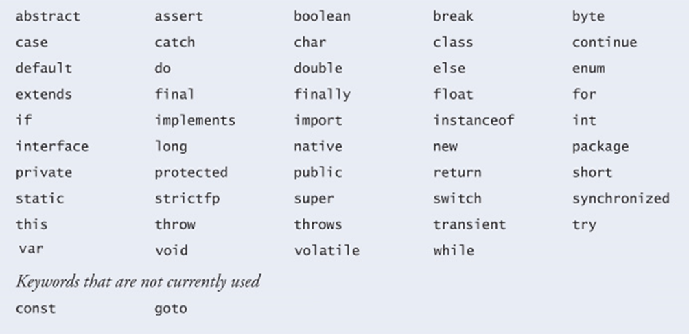
Keywords

Slide 19
Variables
Characteristic
Type
Name
Value
Types
Instance Variables (Non-Static Fields)
Class Variables (Static Fields)
Local Variables
Parameters (arguments)

Slide 20
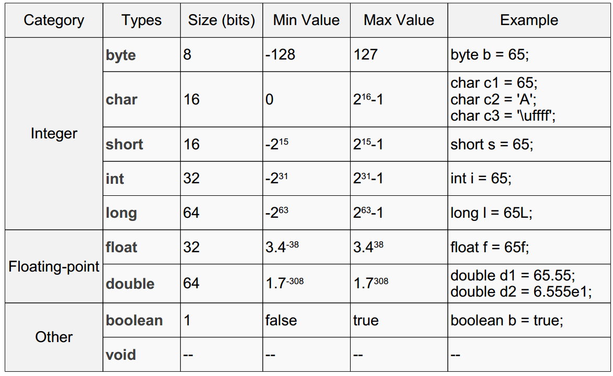
Primitive datatypes

Slide 21
Literals
A literal is the source code representation of a fixed value (without requiring computation)
int value = -12; int un = 1_234_567_000;
double decimal1 = 10f; long l = 100L;
boolean b = true; char c = 'Z';
Notes:
By default, the integer literal primitive type is int. If you want a long, add a letter L suffix

Slide 22
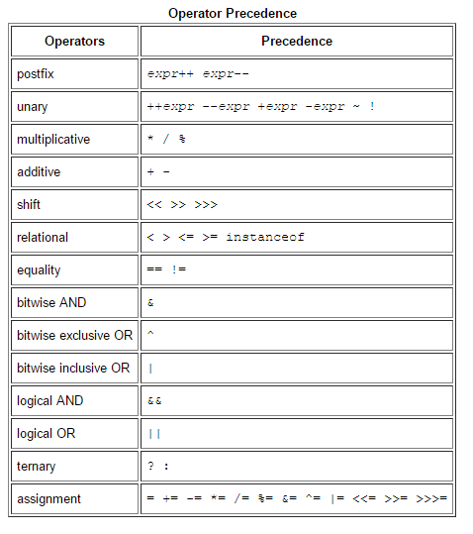
Operators

Slide 23
What will be printed?
public class HelloWorld { public static void main(String args[]) { int a = 5; int b = a; a = 3;
System.out.println(b); } }

Slide 24
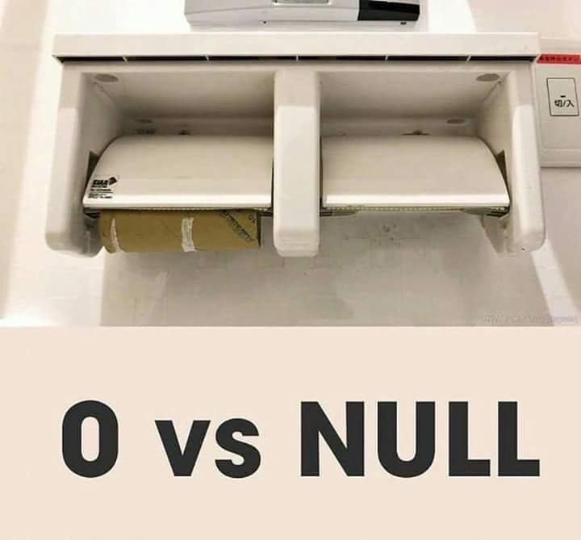
Non-primitive datatypes
Only objects can be null
Primitive types – can not
String text = "This is a String"; Object object = null;
Animal dog = new Dog("Sirko");

Slide 25
Object
public class Dog { private String breed; private int age; private String color; void barking() { // … } void hungry() { // … } void sleeping() { // … } }
Notes:
String, Animal, Object, Integer, arrays, collections,…

Slide 26
What will be printed?
Point p1 = new Point(3,5); Point p2 = p1; p1.x = 7; print(p2.x); Point p3 = new Point(3,5); Point p4 = p3; p3 = new Point(7,9); print(p4.x);

Slide 27
Arrays
int array[] = new int[5]; for (int i = 1; i <= 5; i++) { //Indexing start from 0 array[i] = i * i; }
int anotherArray[] = {1, 4, 9, 16, 25}; // Can store multiple values inside
Object j[] = {}; Object k[] = new Object[0];
String matrix[][] = {{"aaa", "bbb", "cde"}, {"1", "2"}};

Slide 28
Access modifier vs Access level
Access modifiers
public
protected
private
Access levels
public
protected
package private
private

Slide 29
Field modifiers
static – field can be accessed without class instance
final – field can not be reassigned
public, private, protected – access modifier
transient - field should not be serialized or deserialized (static fields are non serializable by default)
volatile – signal to the thread put and get variable directly from memory

Slide 30
Method modifiers
abstract – can not have body, should be implemented by children
final – can not be overridden
public – access modifier
static – method can be accessed without class instance
strictfp – force all JVM do operation with float numbers in the same way

Slide 31
Class modifiers
abstract – can not be instantiated
final – can not be extended
public, private – access modifier
static – can be instantiated without enclosing class

Slide 32
Conditional operator if else
int n = readNumber(); if (n == 1) { System.out.println("1"); } else if (n == 2 || n == 3) { System.out.println("2 or 3"); } else if (n == 4) { System.out.println("4"); } else { System.out.println("5"); }

Slide 33
Conditional operator switch
int n = readNumber(); switch (n) { case 1: System.out.println("1"); break; case 2: case 3: System.out.println("2 or 3"); break; case 4: System.out.println("4"); break; default: System.out.println("5"); }

Slide 34
Conditional operator switch (What is wrong?)
int n = 2; switch (n) { case 1: System.out.println("1"); break; case 2: case 3: System.out.println("2 or 3");
case 4: System.out.println("4"); break; default: System.out.println("5"); }

Slide 35
Conditional loop while “do”
while (condition) { statement; }
int count = 1; while (count < 5) { System.out.println(count); count++; }

Slide 36
Conditional loop while “do”
do { statement; } while (condition);
int count = 1; if (count < 5) { do { System.out.println(count); count++; } while (count < 5); }

Slide 37
Conditional loop for
for (initialization; condition; increment){
statement;
}
for (int count = 0; count < 5; count++) { System.out.println(count); }

Slide 38
Branching statement break
int maxRetries = 10; for(int i = 0;;) { if(i > maxRetries){ break; // stop iteration
} doSomething();
i++; }

Slide 39
Branching statement continue
for(int i=0;; i++) { if(i % 5 == 0){
doSomethingAnother();
continue; // continue iteration
} doSomething(); }

Slide 40
Branching statement return
for(int i = 0; i < 10; i++) { if(i > 5) { return -1; // stop iteration and exit from method } doSomething(); }
return result;

Slide 41
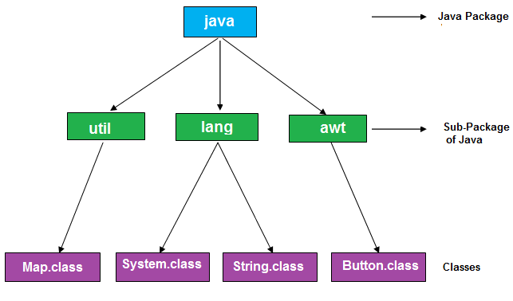
Packages
Set of classes/resources and/or sub-packages
Should be declared before imports in class
Only one package can be declared in class
java.util.Map map = new java.util.HashMap();

Slide 42
Imports
import <packagename>.<classname>;
java.lang is imported by default
Importing a Package Member
import java.util.Map; import java.util.HashMap;
….
Map map = new HashMap();
Importing an Entire Package
import java.util.*;
….
Map map = new HashMap();

Slide 43
Imports clashes
package gh; import java.awt.Point;
import java.util.*; class Point { // ... }
// compilation fails

Slide 44
Imports order
import java.util.*;
package gh;
class Point { // ... }
// compilation fails

Slide 45
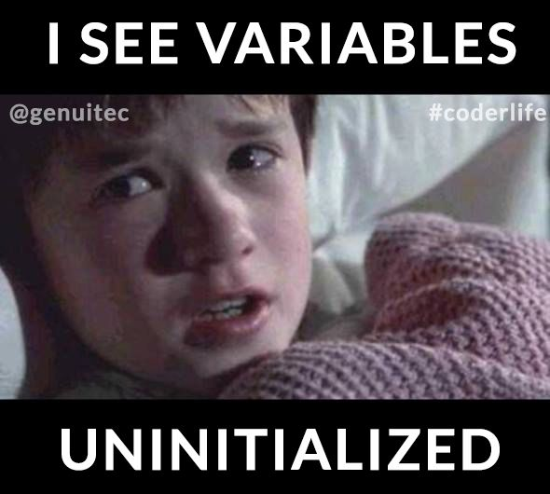
Garbage Collector

Slide 46

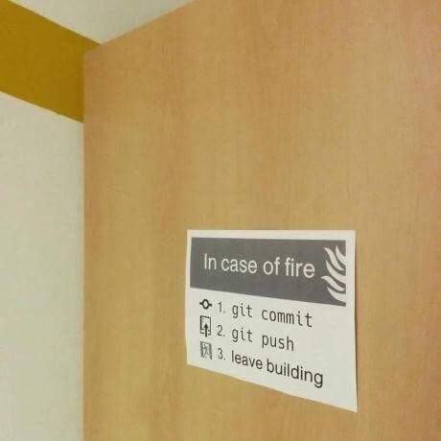
Control Version System (CVS)

Slide 47

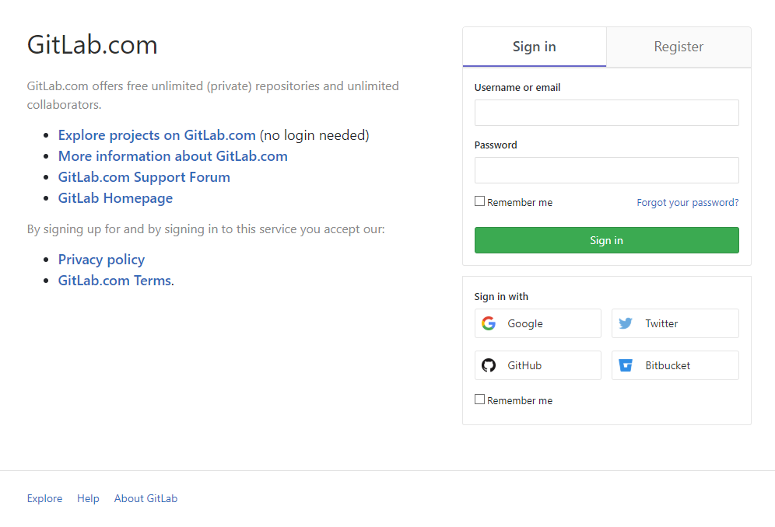
Cloud repository

Slide 48
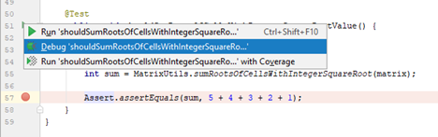
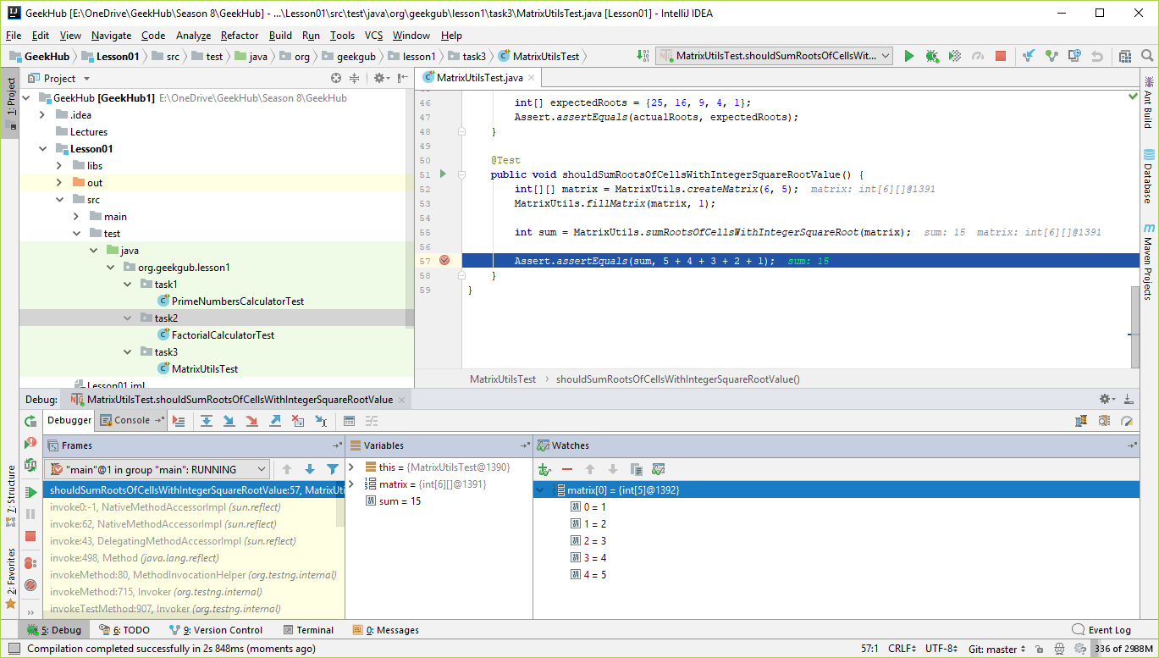
Use debugger

Slide 49
Literature
Read and follow Java Code Conventions
By Oracle
By Google
Read official intro doc
Getting started
Language Basics
Classes and Objects
Read about git
Git tutorial
Git trainer
Read about IDEA
IntelliJ IDEA
Applications to install and CVS system
Gitlab
Intellij IDEA
GIT
JDK 11

Slide 50
Homework
Install JDK 11
Install IDEA 2018.2.4 Community Edition
Install GIT
Register on https://gitlab.com
Fork repository git@gitlab.com:olexandr.kucher/geekhub8.git and name it `geekhub8`
One module per lesson
Separate package for task (with sub-packages if needed)
Module name: Lesson##
Package name: org.geekhub.lesson#.task#
Invite olexandr.kucher and y.brahinets to your Gitlab repository as administrators
Use `L##-T# {Message}` prefix for commits messages (ex: L01-T3 Implement unit tests)
Do not use collections framework in home tasks (only technologies covered by lecture)

Slide 51
Homework Task 1
Implement PrimeNumbersCalculator. Program should accept one number as command line argument: upper bound for prime number (exclusive). Print all prime numbers less than entered bound in reverse order. Conditions :
If user did not provide input or input is non-positive – print error and exit program with error status;
All tests in PrimeNumbersCalculatorTest.java should pass successfully.

Slide 52
Homework Task 2
Implement FactorialCalculator. Program should accept one number as command line argument: factorial count. Calculate N factorial and print total value on screen. Сonditions:
If user did not provide input or input is non-positive – print error and exit program with error status;
If user inputs number from 1 inclusive to 10 exclusive – print value for calculated factorial;
If user inputs too big number (10 or more than 10) – print warning that operation is time-consuming and prompt user for confirmation. If user confirms – print value for calculated factorial, otherwise just exit;
All tests in FactorialCalculatorTest.java should pass successfully.

Slide 53
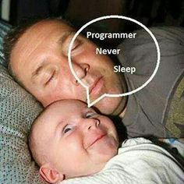

Slide 54
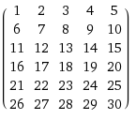
Homework Task 3
Implement MatrixUtils and sample program of its usage. Prompt user to input two numbers: columns and rows
Create and fill matrix by incremental values (see example);
Find cells whose value has integer square root;
Print cells indexes, values and roots values in natural order;
Print roots in reverse order;
Print sum of all these roots;
All tests in MatrixProcessorTest.java should pass successfully.
For example: users inputs rows = 6, cols = 5, then initial matrix looks like
cell[0,0] has value 1, it’s root: 1
cell[0,3] has value 4, it’s root: 2
cell[1,3] has value 9, it’s root: 3
cell[3,0] has value 16, it’s root: 4
cell[4,4] has value 25, it’s root: 5
Total: 5+4+3+2+1 = 15

Slide 55
Q&A

